Slide 1


Cryptocurrency Analysis
2018
Alex garfias
Andrew Scott
Aritra ghosh
Brandon leal

Slide 2

Team Motivation for Crypto
Much of our motivation surrounding choosing crypto currency is because it’s a hot topic right now.
We wanted to know based on historical data if crypto currencies were a good option for long term investments?
Using historical data are crypto currencies a good choice to use to trade with?
Do currency changes correlate with each other?
We leveraged Bitcoin, LiteCoin, and Ethereum

Slide 3
Results High-level
Based off of 2018 historical data, crypto currencies do not make a good long term investment
However choosing to trade currencies can make for a profitable portfolio as you will see in the next few slides
Daily variances vary greatly
The high volatility of the cryptocurrency vs other investments markets drives investors away, although it has gained popularity in the last few years, investors seem very hesitant and do not consider it as a greatest investment option.

Slide 4

Data Cleaning and Exploration
Initial data gathering proved to be more difficult than we anticipated, many sites wanted us to subscribe to gather historical data
Google has depreciated their finance API
Yahoo API is no longer updated, and has minimal documentation
Ultimately data was extracted from Coinbase, Yahoo, and QuantConnect
Data scrubbing was completed- gathering our data into dataframes, changing decimals to whole numbers, creating moving averages, normalizing –percent change
Connecting to Twitter data proved to be a challenge
To evaluate data for trading Monte Carlo simulations were completed

Slide 5
HISTORY & EVOLUTION
1998 – 2009 was the pre-Bitcoin period.
Although Bitcoin was the first established cryptocurrency, there had been previous attempts at creating online currencies, two examples of these were B-Money and Bit Gold, which were formulated but never fully developed.
In 2009, a paper called Bitcoin – A Peer to Peer Electronic Cash System was posted to a mailing list discussion on cryptography by Satoshi Nakamoto, whose real identity remains a mystery.
Bitcoin serves as a decentralized medium of digital exchange, with transactions verified and secured through encryption and “smart contracts” .. (the blockchain) that makes the entity virtually unhackable and void of fraud without the need for a trusted record keeping authority or central intermediary.
In 2010, Bitcoin is finally valued, then in 2011 rivals appear (Namecoin & Litecoin) which led to Bitcoin crash in 2013.
Ethereum appears in 2016 enabling the cryptocurrency known as Ether to facilitate blockchain-based smart contracts and apps.

Slide 6
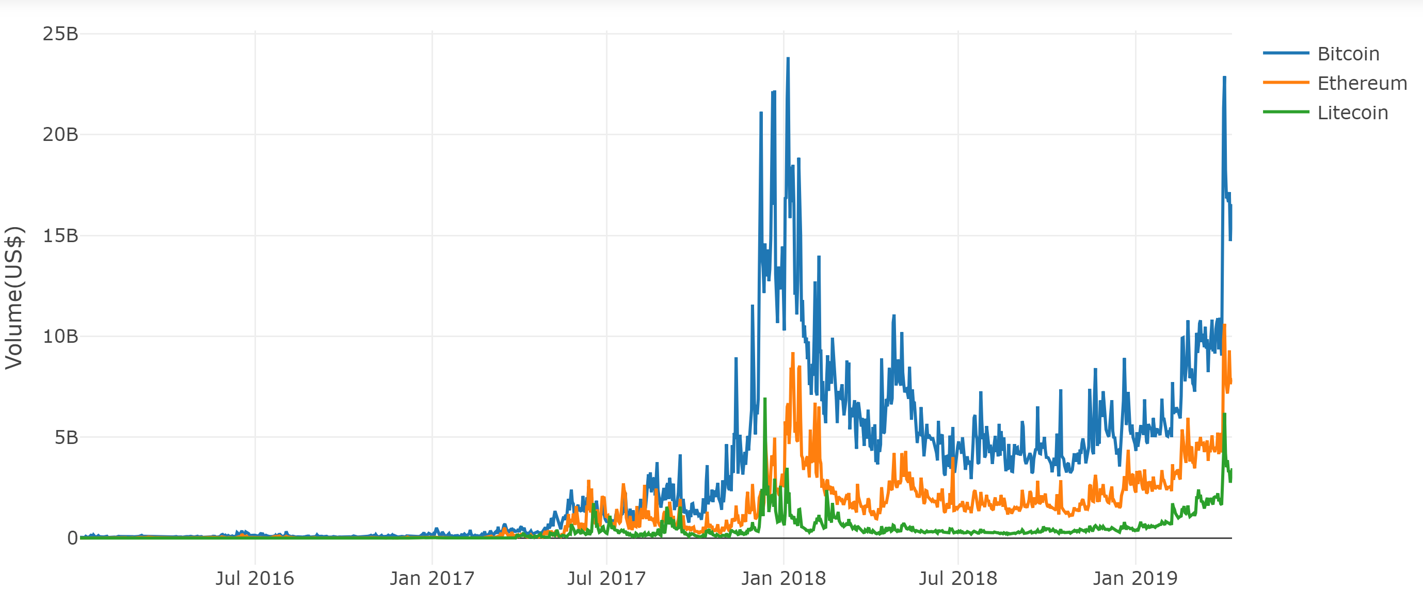
Volume Comparison
In 2017 cryptocurrency had a huge spike in the market specially Bitcoin but in 2018 it experienced a huge fall. Among the top cryptos, the fall was (around -34%).
BTC fell by -73%, which actually correlates to its long term volatility.
Average Trading Volume
(Jan 2016– Apr 2019)
BTC: 3.321736e+09
ETH: 1.275877e+09
LTC: 3.686165e+08

Slide 7
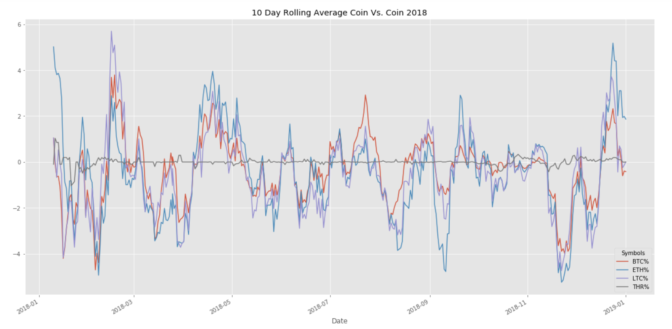

Coin vs. Coin Comparisons
What do the daily changes look like compared to the Dollar?
Mean % Change 2018
BTC% -3.395422e-01
ETH% -4.556945e-01
LTC% -5.310612e-01
Coin with the greatest variance?
LiteCoin- Nearly 30% up
And 25% down in a single day!
Is there a correlation between daily changes?
Coin vs. Coin P-Value = 0.2500
P-Value W/ Tether = 1.7157990391769624e-07

Slide 8
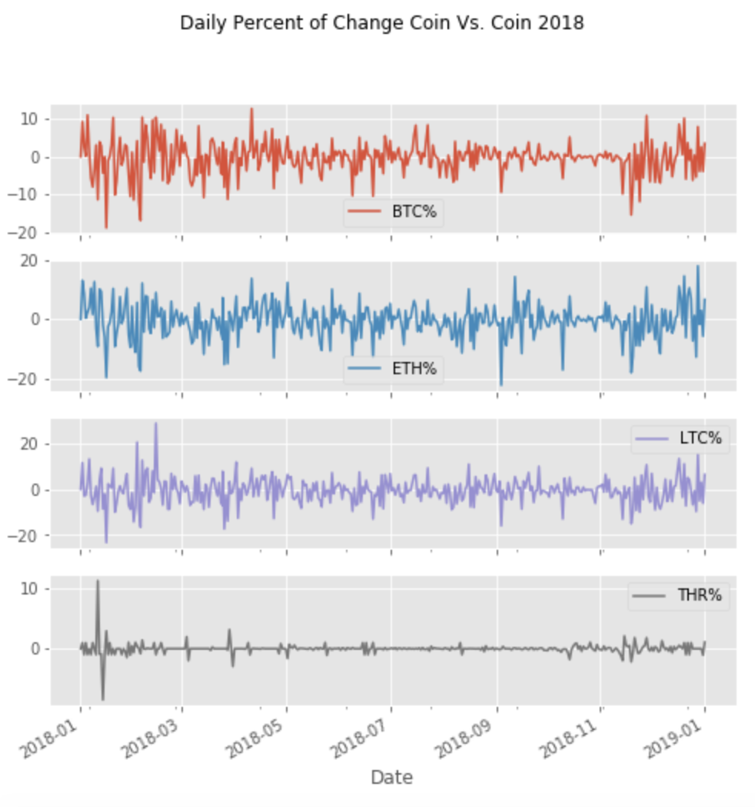
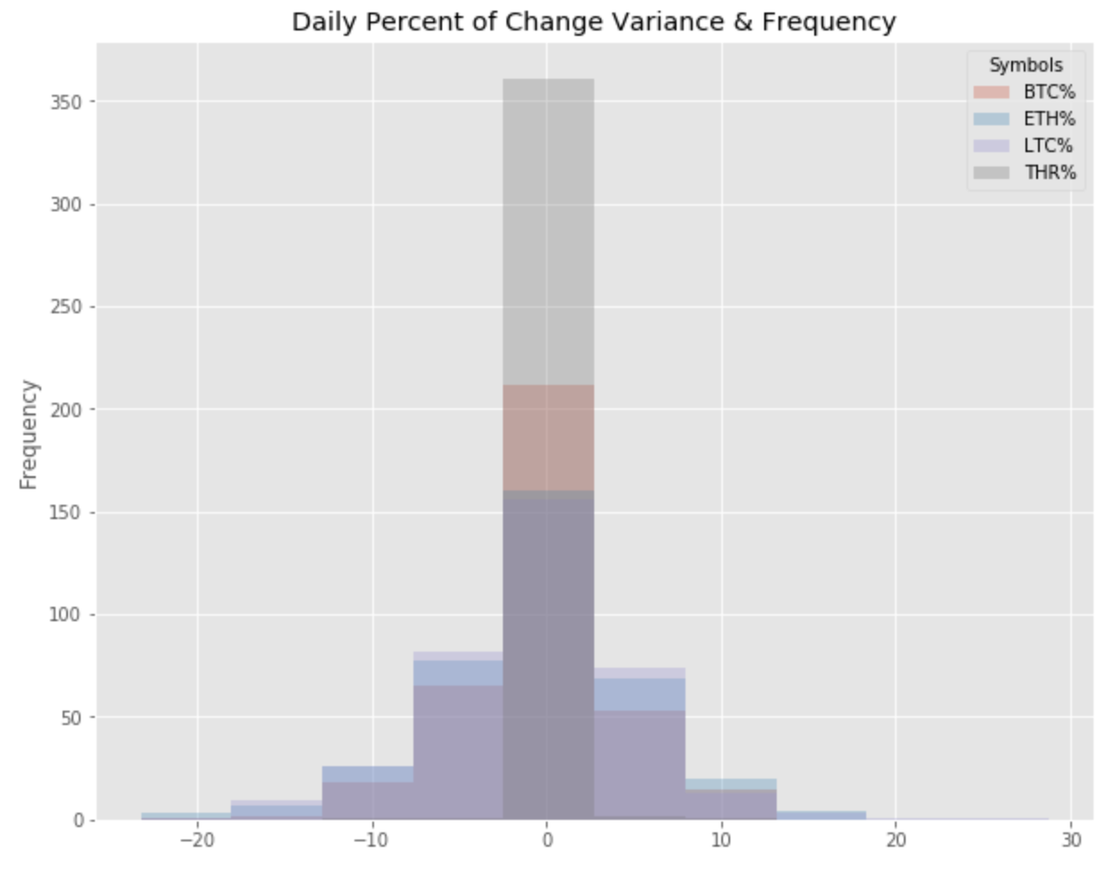
Coin vs. Coin Comparisons
Which coin has the most variance?
Wild daily variances observed from +30% to -25%
Note Tether (USD) stays very consistent with minimal change

Slide 9
What is Cryptocurrency Hedging?
Hedging is a risk reduction strategy that typically involves taking an offsetting position on one’s primary asset, it provides insurance, reducing the potential for loss.
Hedging Methods:
Although diversification is a common way to mitigate risk in the stock market, it looks somewhat different in the cryptocurrency market.
Most coins are very volatile and the market generally trends together day to day.
The best strategy for hedging against too much risk is to build the foundation of your portfolio on the most reputable coins, such as Bitcoin, Ethereum and Ripple which are the least volatile and could be decent hedges against other riskier coins. It is important to maintain a healthy mix.
Another tip for hedging cryptocurrencies, is to make an account on an exchange that lets you hold money in fiat currency as well as cryptocurrency.
This makes it easy to transfer money in between and not get stuck in a bind if a major crash occurs.
This also allows you to quickly take advantage of optimal exchange rates and adjust the proportion of money you have invested.
You can also invest in Tether, a cryptocurrency that tracks its value with that of the U.S. dollar, and trade in and out of other coins that way.

Slide 10
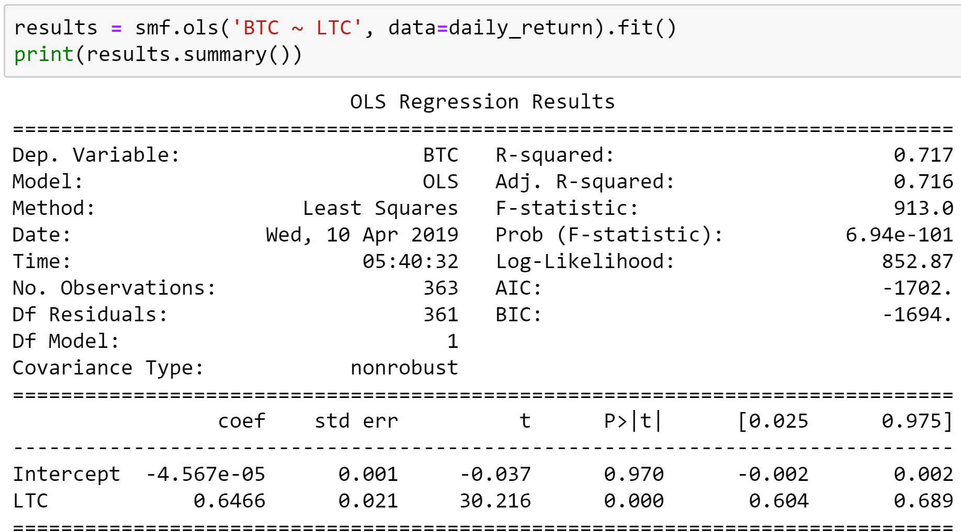
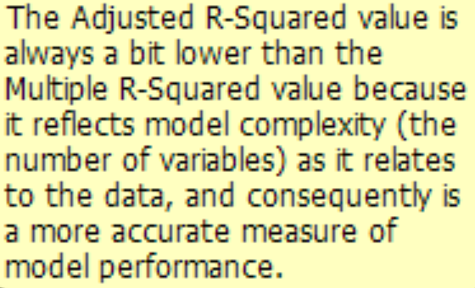
Cryptocurrency historic regression
To build a hedging chart, we first had to create a historic regression for 2018; the F-statistics and the prob (f-statistics) are measures of overall model statistical significance. The F-statistics are trustworthy only if the prob (f-statistic) is not significant.

Slide 11
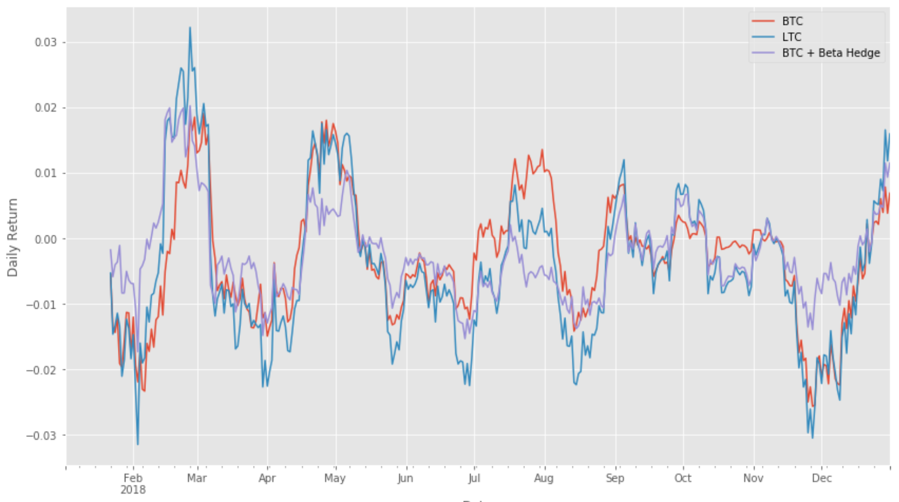
Cryptocurrency Hedging Chart
A good way to understand hedging is to think of Gap insurance; although, there is a difference -Gap insurance involves paying someone to bear the risk, while hedging involves making an investment to offset the risk.
This graph shows the hedging line to offset the risk on BTC only, and as you can see hedging played a significant role protecting the investment in rough times, thus avoid a greater loss.

Slide 12
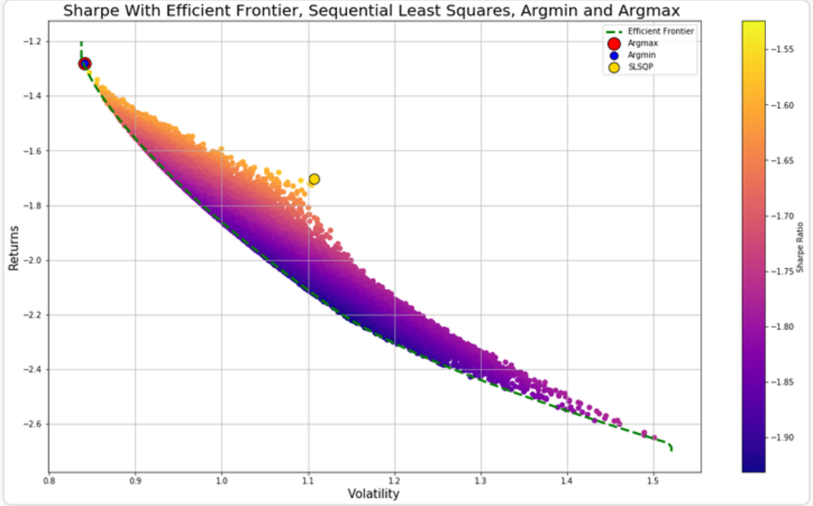
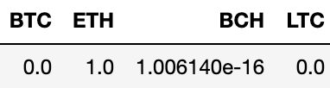
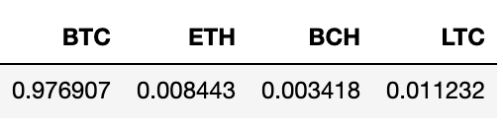
SHARP RATIO
The SLSQP makes sense because the coins all trade very close together
Argmin and Argmax returned the same portfolio because crypto sucks.

Slide 13
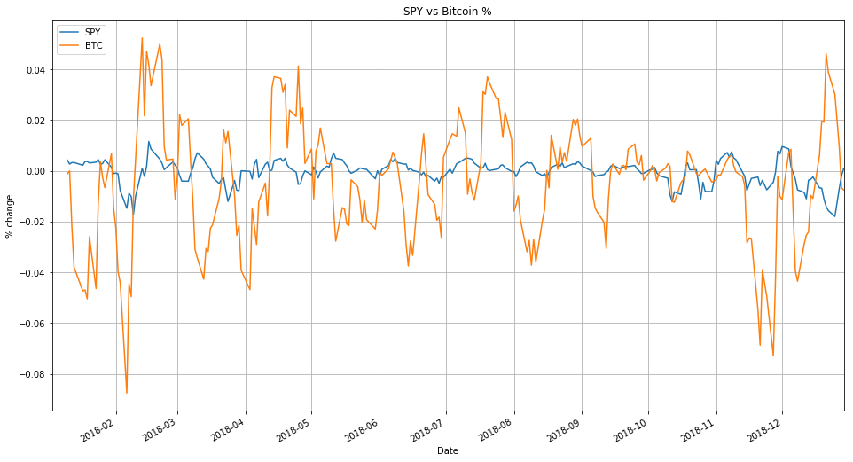
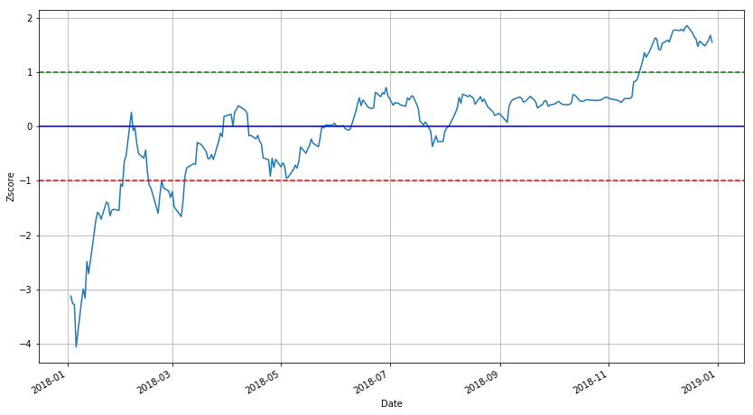
SPY & BTC
Correlation coefficient of .065

Slide 14
Trading Strategies
These can live trade
with GDAX
This is all paper trading but the fees would be real if you went live.
If you can’t long Crypto maybe you can trade it over short periods of time.
Buy at the 14th hour of the day because higher volume.
These buy when the 7 day EMA passes the 30 day EMA and sells at the 19 hour of every day.
Taking an idea from SLSQP and only trading ETH
Taking an idea by being basic and just trading Bitcoin
Since they move together try trading the best of the 7 EMA > 30 EMA

Slide 15
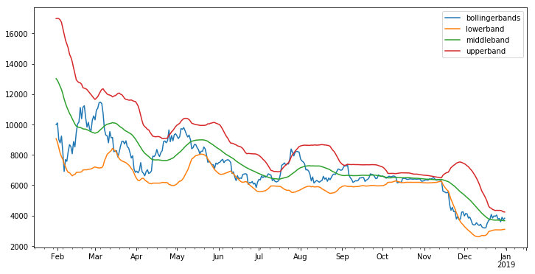
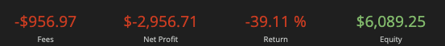
Trading Strategies Part 2!
Take the 20 day Moving Average,
Then two Standard Deviations up and down.
Bought when it dipped and sold when it reached the middle band.
Buy when crosses the upper band sell when it hits middle band

Slide 16
Questions or Comments?

